Slide 1

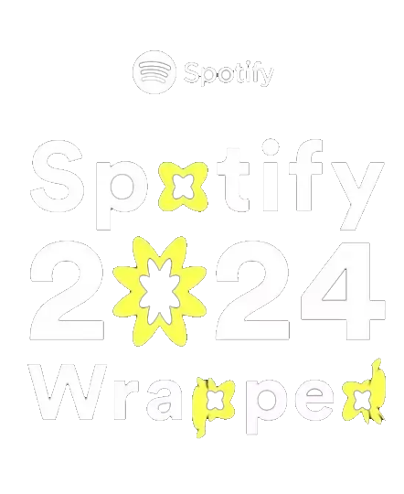





Slide 2


for Artists
Get ready for
2024 Wrapped
Your go – to guide for standing out during the year’s biggest fan moment

Slide 3



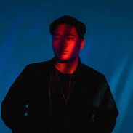

Top Artists
Top Songs
Dabin
Geoxor
TheFatRat
Shiki - TMNS
Laur
Perfect
Sidewalk
I Really Want t ….
E – Girl Bounce
Crazy ( feat. C..
Minutes Listened
Top - Genre
23.498
Electro House
Spotify
SPOTIFY.COM / WRAPPED

Slide 4
"You liked these artists so much, we put them on
the cover of a magazine.
Kind of

Slide 5

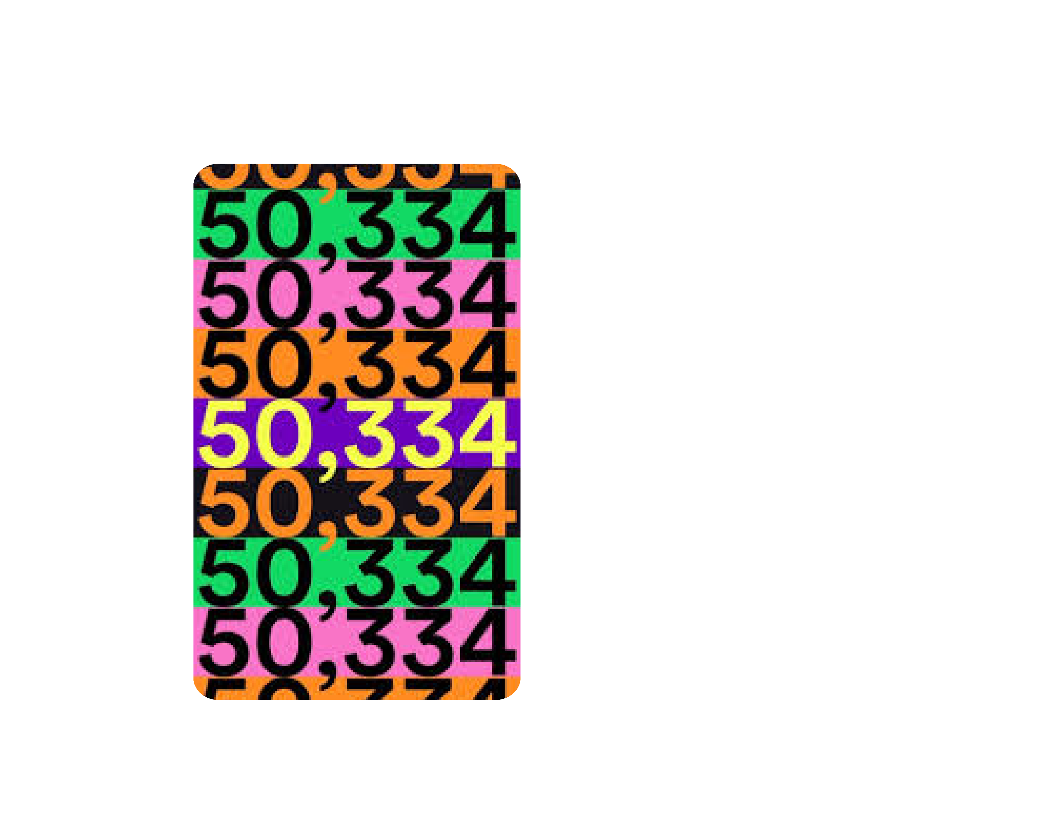





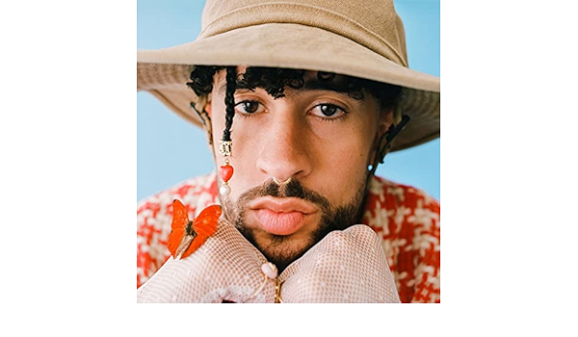

My Listening Personality
My top song
The Fan Clubber
Sweetest Pie
You’re the kind of fan that artists dream of When you love an artist, you dive into their entire discography, exploring both hits and deeper tracks alike..
Megan Thee Stallion (featuring Dua Lipa)
Top Artists
Top Songs
Most Listened on
Arijit Singh
Pritam
Yasser Desai
KK
Shreya Ghoshal
shut up
Didaar (Stand...)
Throwaway (wit...
Jiya Dhadak Dh..."
Dandelions
October 31, 2022
F N V C
Total Streams
243
Total Minutes Listened
Top Genre
16,815
Hip Hop
Spotify
SPOTIFY.COM / WRAPPED
Spotify
SPOTIFY.COM / WRAPPED
Spotify
SPOTIFY.COM / WRAPPED

Slide 6








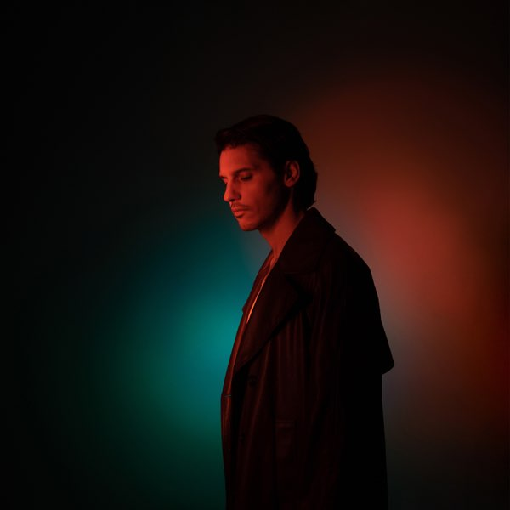

Spotify
Your Top Artist
1
ROLE MODEL
2
Wallows
3
Shawn Mendes
4
Ghost
5
Harry styles

Slide 7
Thank you

Slide 8
Instructions for use
You must credit SlideChef in order to use this template
What you are allowed to do :
Modify this template
Use it for personal or commercial projects
What you are not allowed to do :
Offer SlideChef templates for download
Sublicense, sell or rent any SlideChef content
Distribute SlideChef content unless it has been authorized
Include SlideChef content in an online or offline file
Acquire the copyright of SlideChef content

Slide 9

SlideChef

